Slide 1
Pathways to College and Career: Inclusive Postsecondary Education in Massachusetts
Maria Paiewonsky, Ashley Luce and Rachel Estremera
MA Center for Inclusive Higher Education and Transition
ICI UMass Boston
Work in Progress: Employment and Community Life
May 15, 2025

Slide 2
Session objectives
Provide overview of the MA Inclusive Postsecondary Education Initiative
Review features of the inclusive postsecondary education model
Share case studies from UMass Boston’s Inclusive Education Initiative that highlight how student goals are supported
Feedback

Slide 3
A little background

Slide 4
Massachusetts

Slide 5
Model features
Legislative support since 2007 to:
  Establish college – school partnerships (+ adult services & providers since 2022)
  Planning and implementation funds guided by request for proposal requirements
  Support students 18+ to access college and campus
  Capitalize on generic supports from the college and schools
    Accommodations, tuition waivers, advising, registration, on-campus supports from IHEs.
    Student and family preparation, educational coach support, travel training, program fees from the LEA partners.

Slide 6
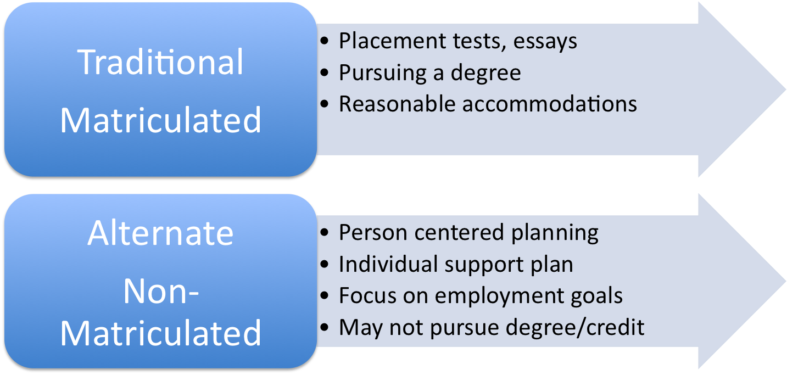
Alternate Pathway to College

Slide 7
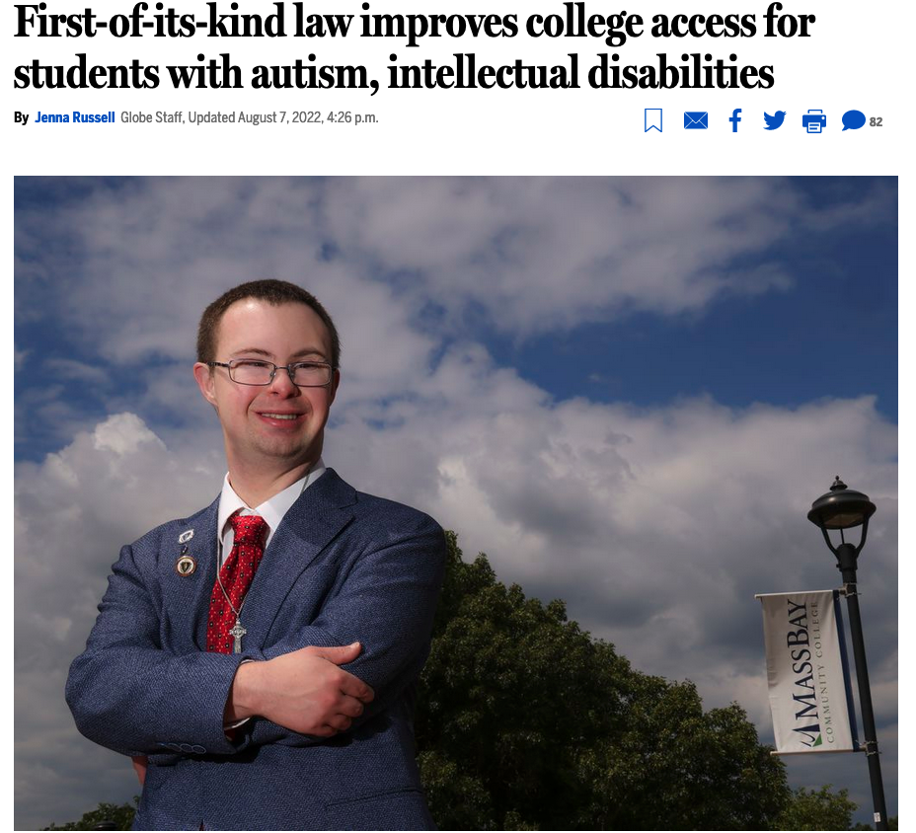
Landmark Legislation-July 2022
Higher Education Bill in Massachusetts Advances Inclusive Postsecondary Education
Provisions remove barriers precluding persons with Intellectual Disabilities and Autism from participating in state colleges and universities.
Provisions ensure state colleges and universities establish guidelines governing selection of individuals with ID and autism as well as course selection.

Slide 8
What’s New?
Budget makes it possible to support more MA public colleges and universities to apply for funding.
Individuals who have exited school without a diploma, with severe intellectual disabilities, severe autism spectrum disorders and other severe developmental disabilities have the opportunity to participate in college as non-matriculated students, in consultation with and support from the Department of Higher Education and Think College/Massachusetts Center for Inclusive Higher Education and Transition.

Slide 9
Expanded Partnerships
In addition to colleges and K-12 partners, MA adult service agencies will be encouraged to collaborate with MA Inclusive Higher Education partners on funding, policies and practices that best support individuals participating in college.

Slide 10
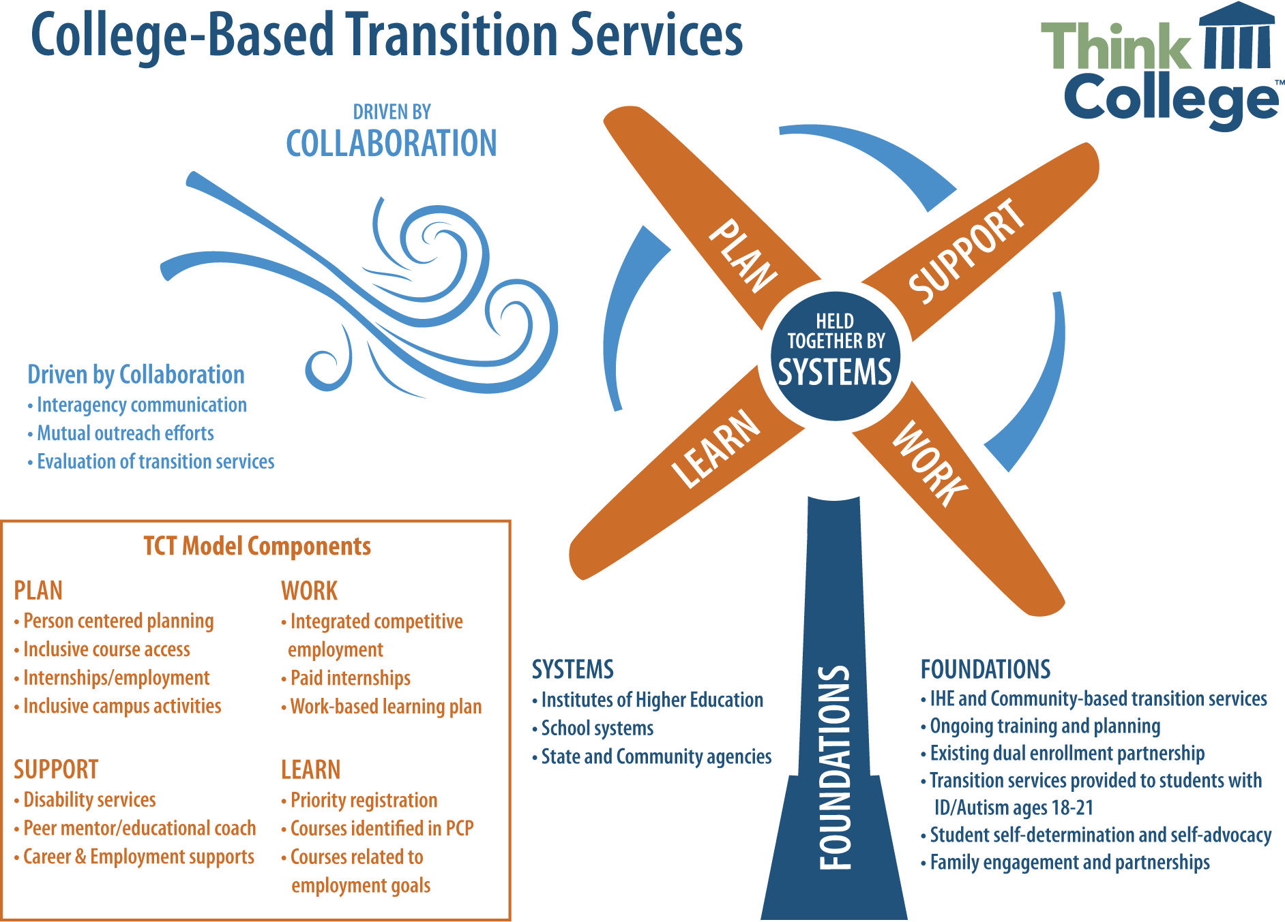
College-Based Transition Services

Slide 11






OVERVIEW OF MA Inclusive Higher Education
(2007-PRESENT)
Students participate in:
Person-centered planning
Students are fully included in the campus community as they develop their capacities in
career-planning
employment
self-advocacy
other self-determined abilities supporting their interests and activities
College or university courses that support their goals
Paid work and internships
Social activities on campus, student organizations, other extracurricular activities
Independent living and independent travel
Notes:
Let me take just a minute to review what we mean when we say including students in college. All participating public IHEs and their school partners are funded to offer these opportunities.

Slide 12
Intended goal
Courses
Related work experiences
Integrated paid employment
Person-centered planning

Slide 13
Expected courses and campus and community work experiences
Course selection is from general course catalog
Audit, non-credit and credit courses
Access to campus resources (e.g., Career Services)
Courses aligned with postsecondary goals:
  Direct link to careers
  Related career skills
Work experiences developed by school and college partners
MA Work-based learning plans
Campus-based internships

Slide 14
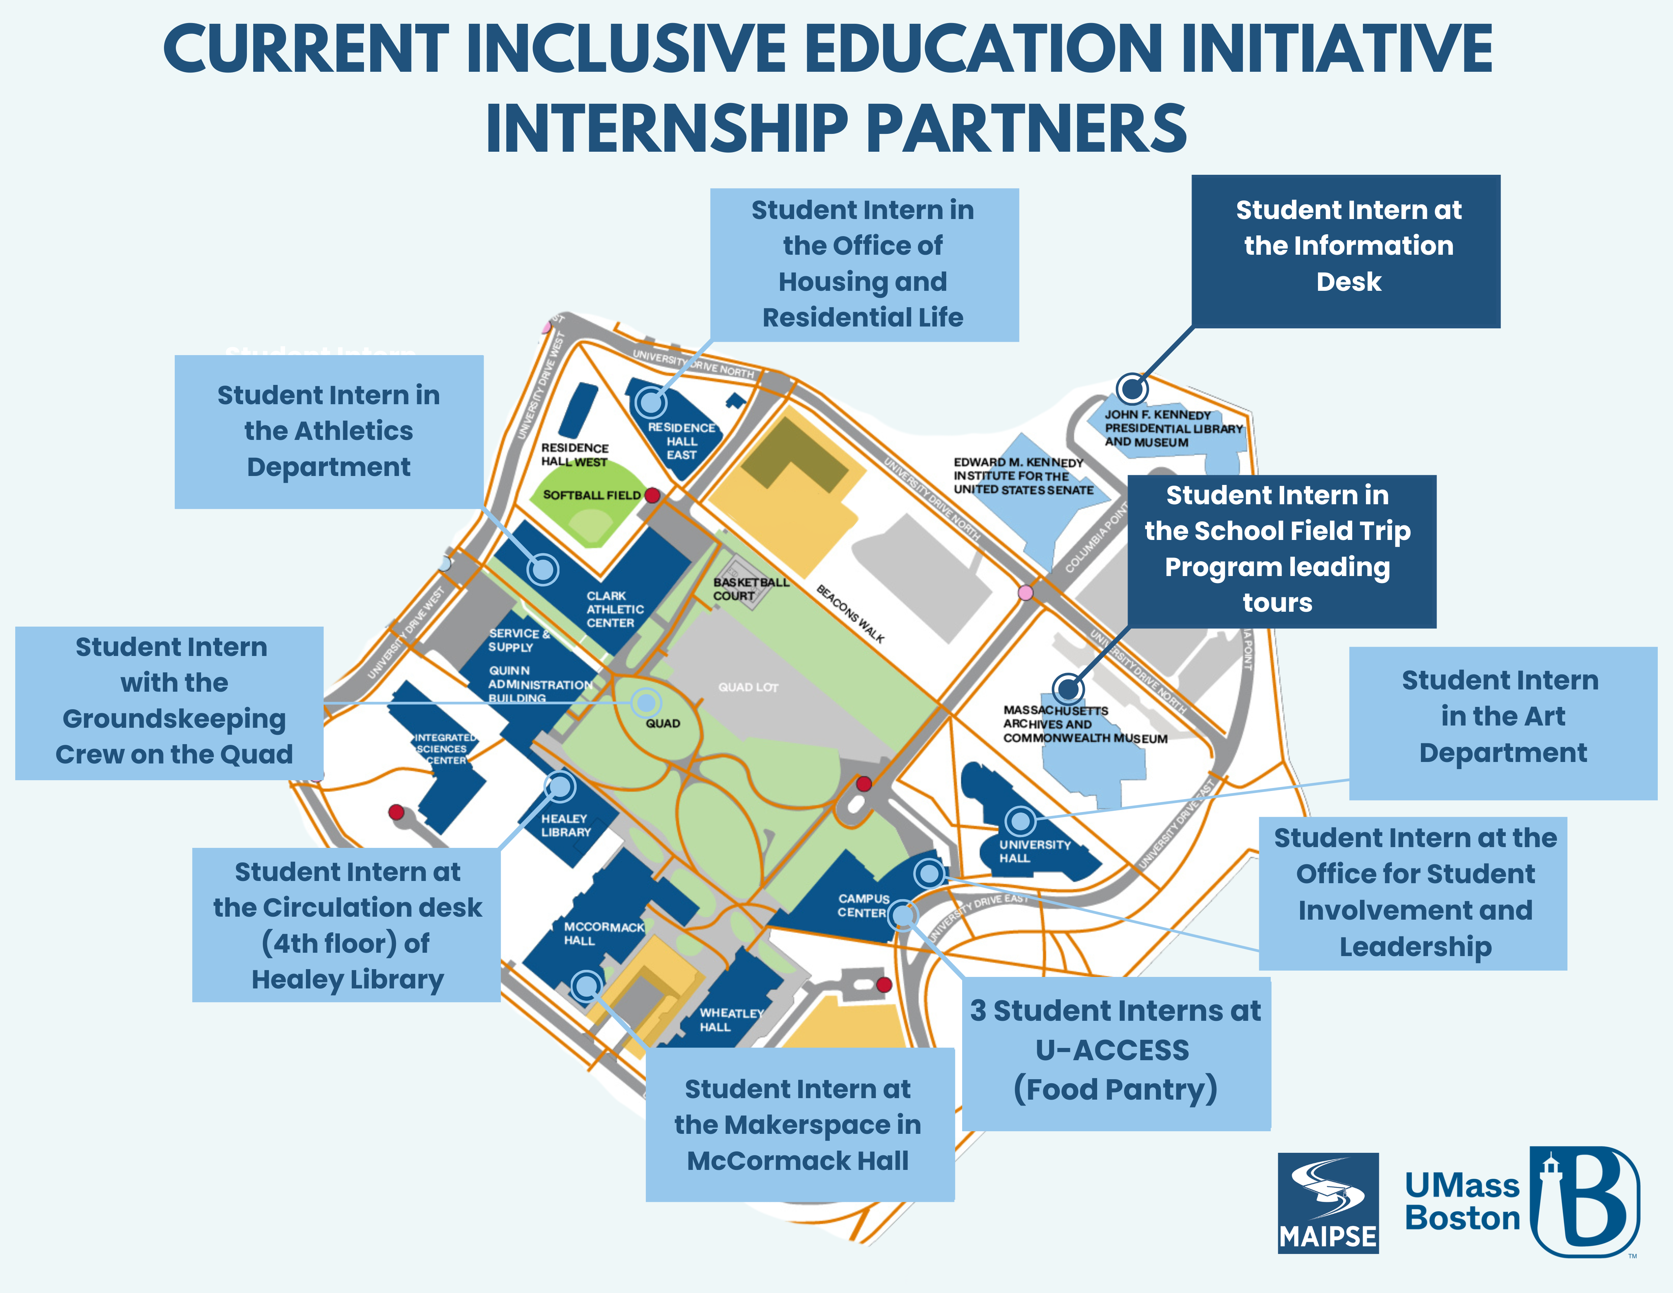
Current Inclusive Education Initiative Intership Partners

Slide 15
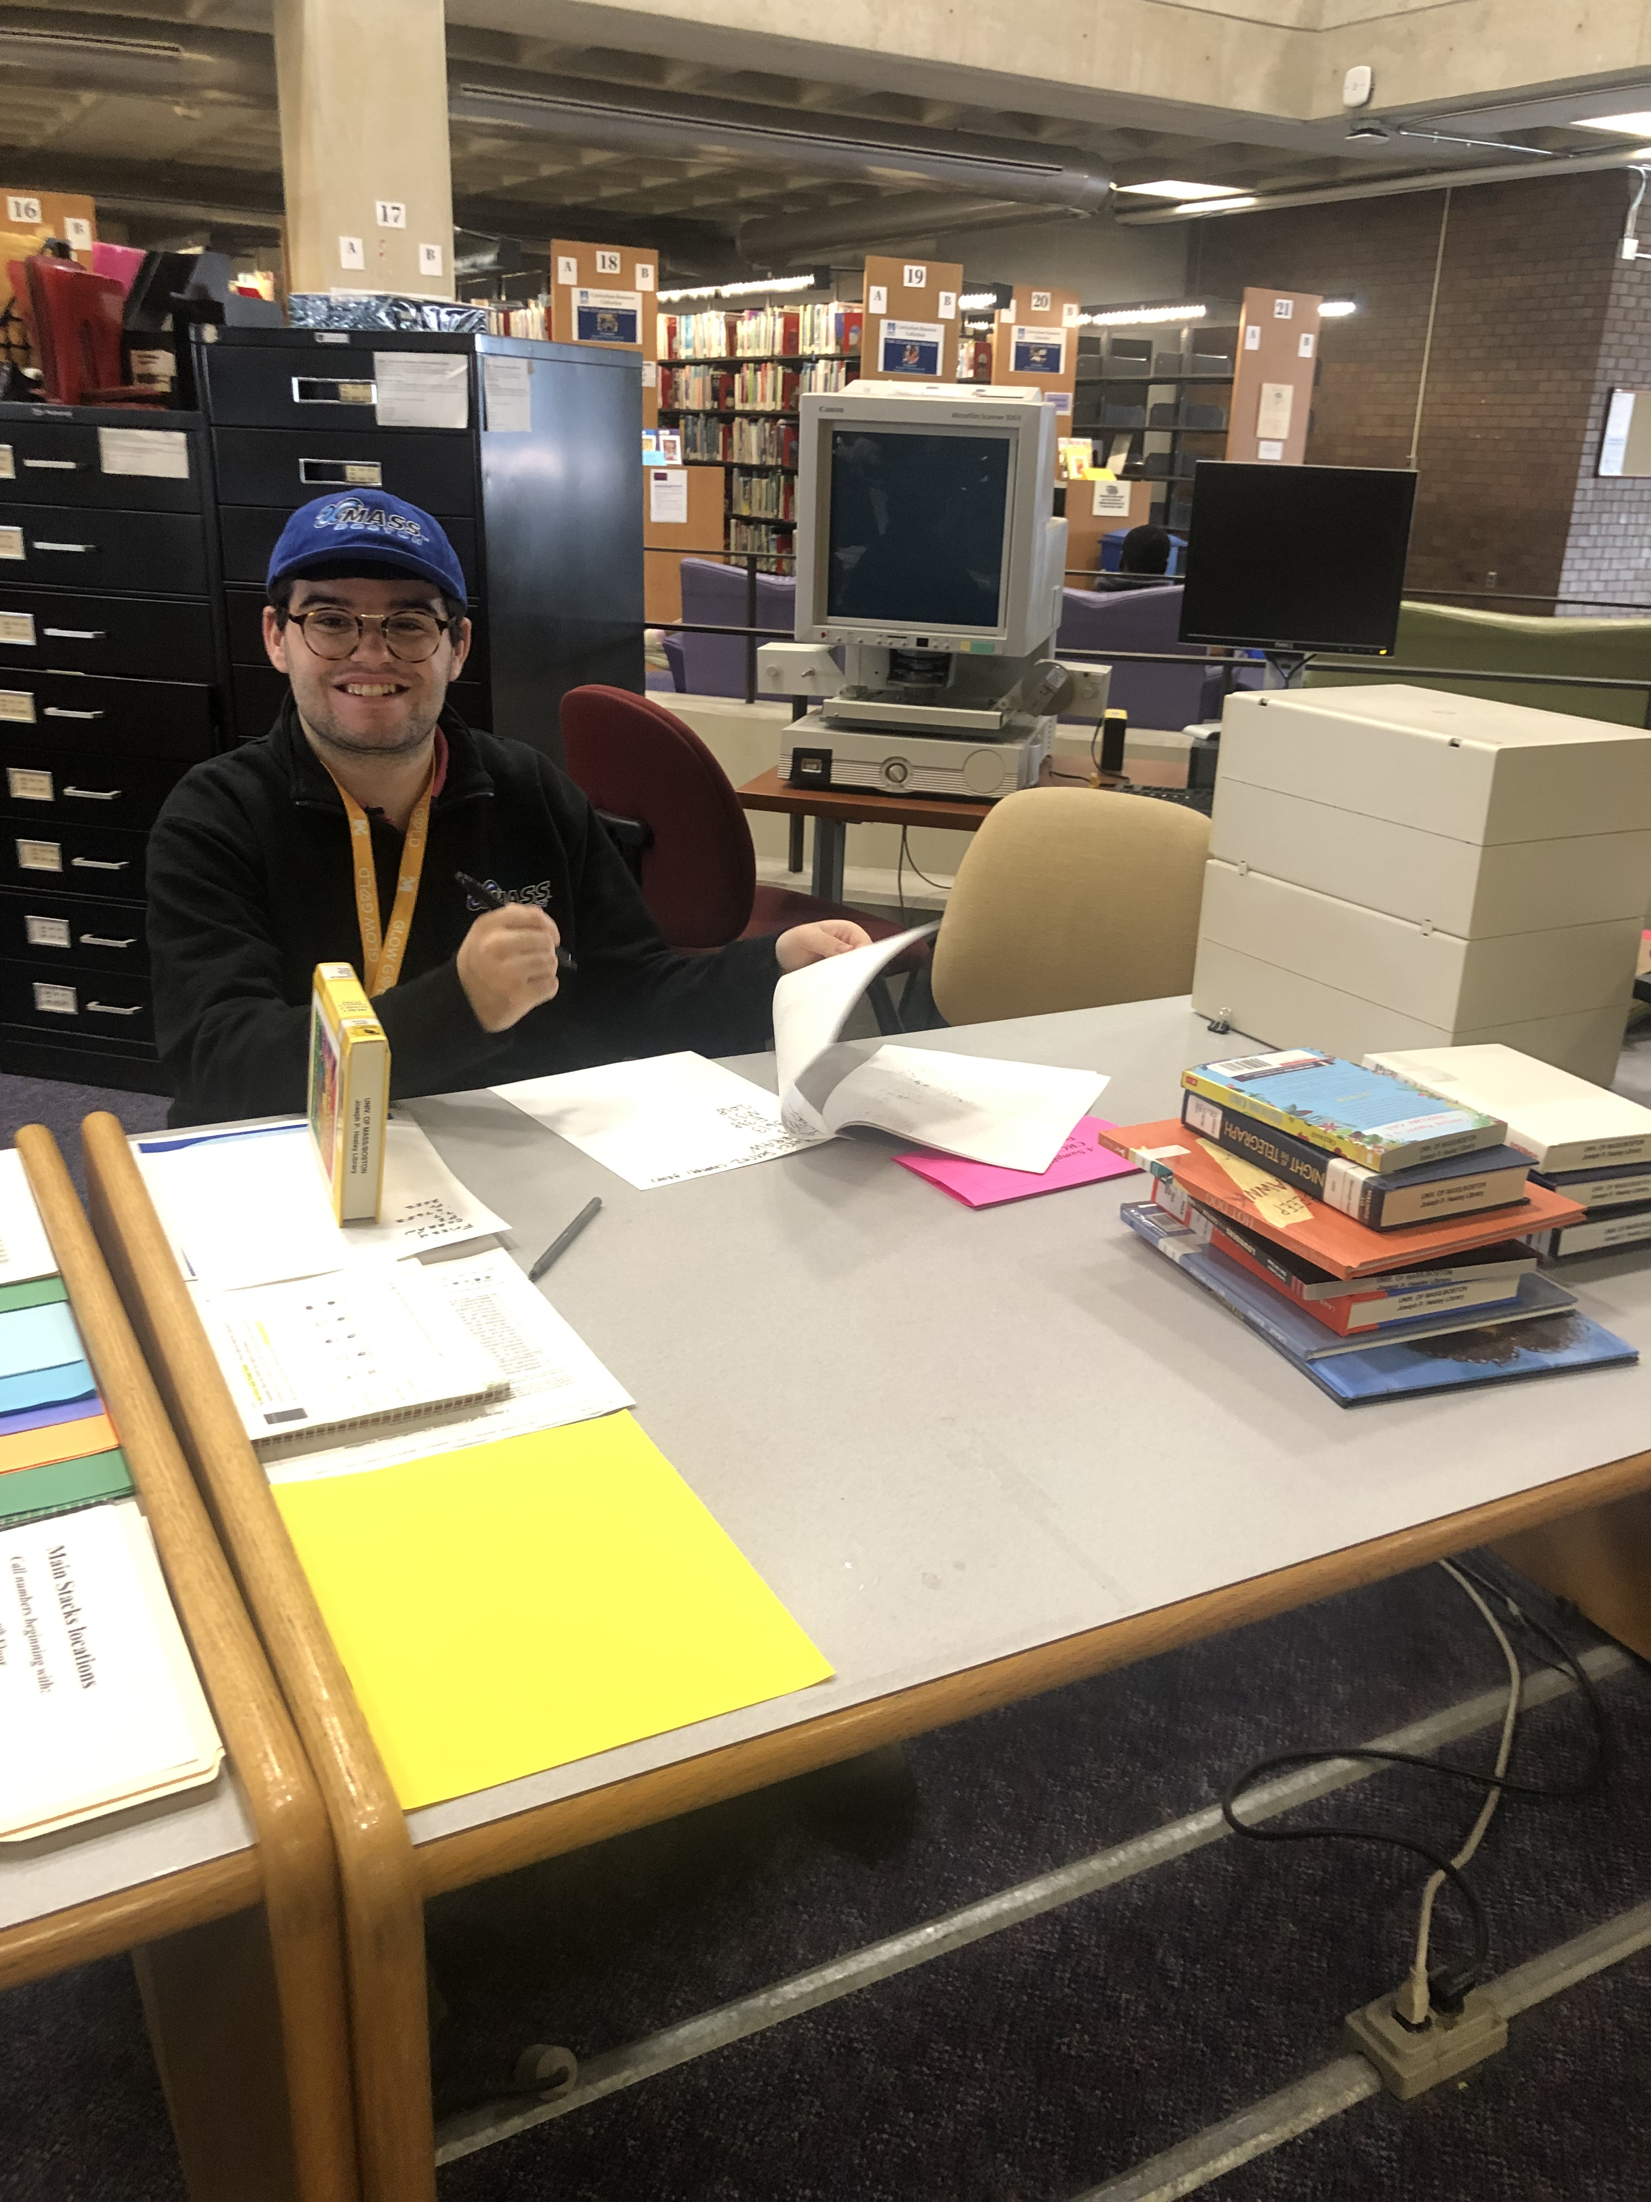
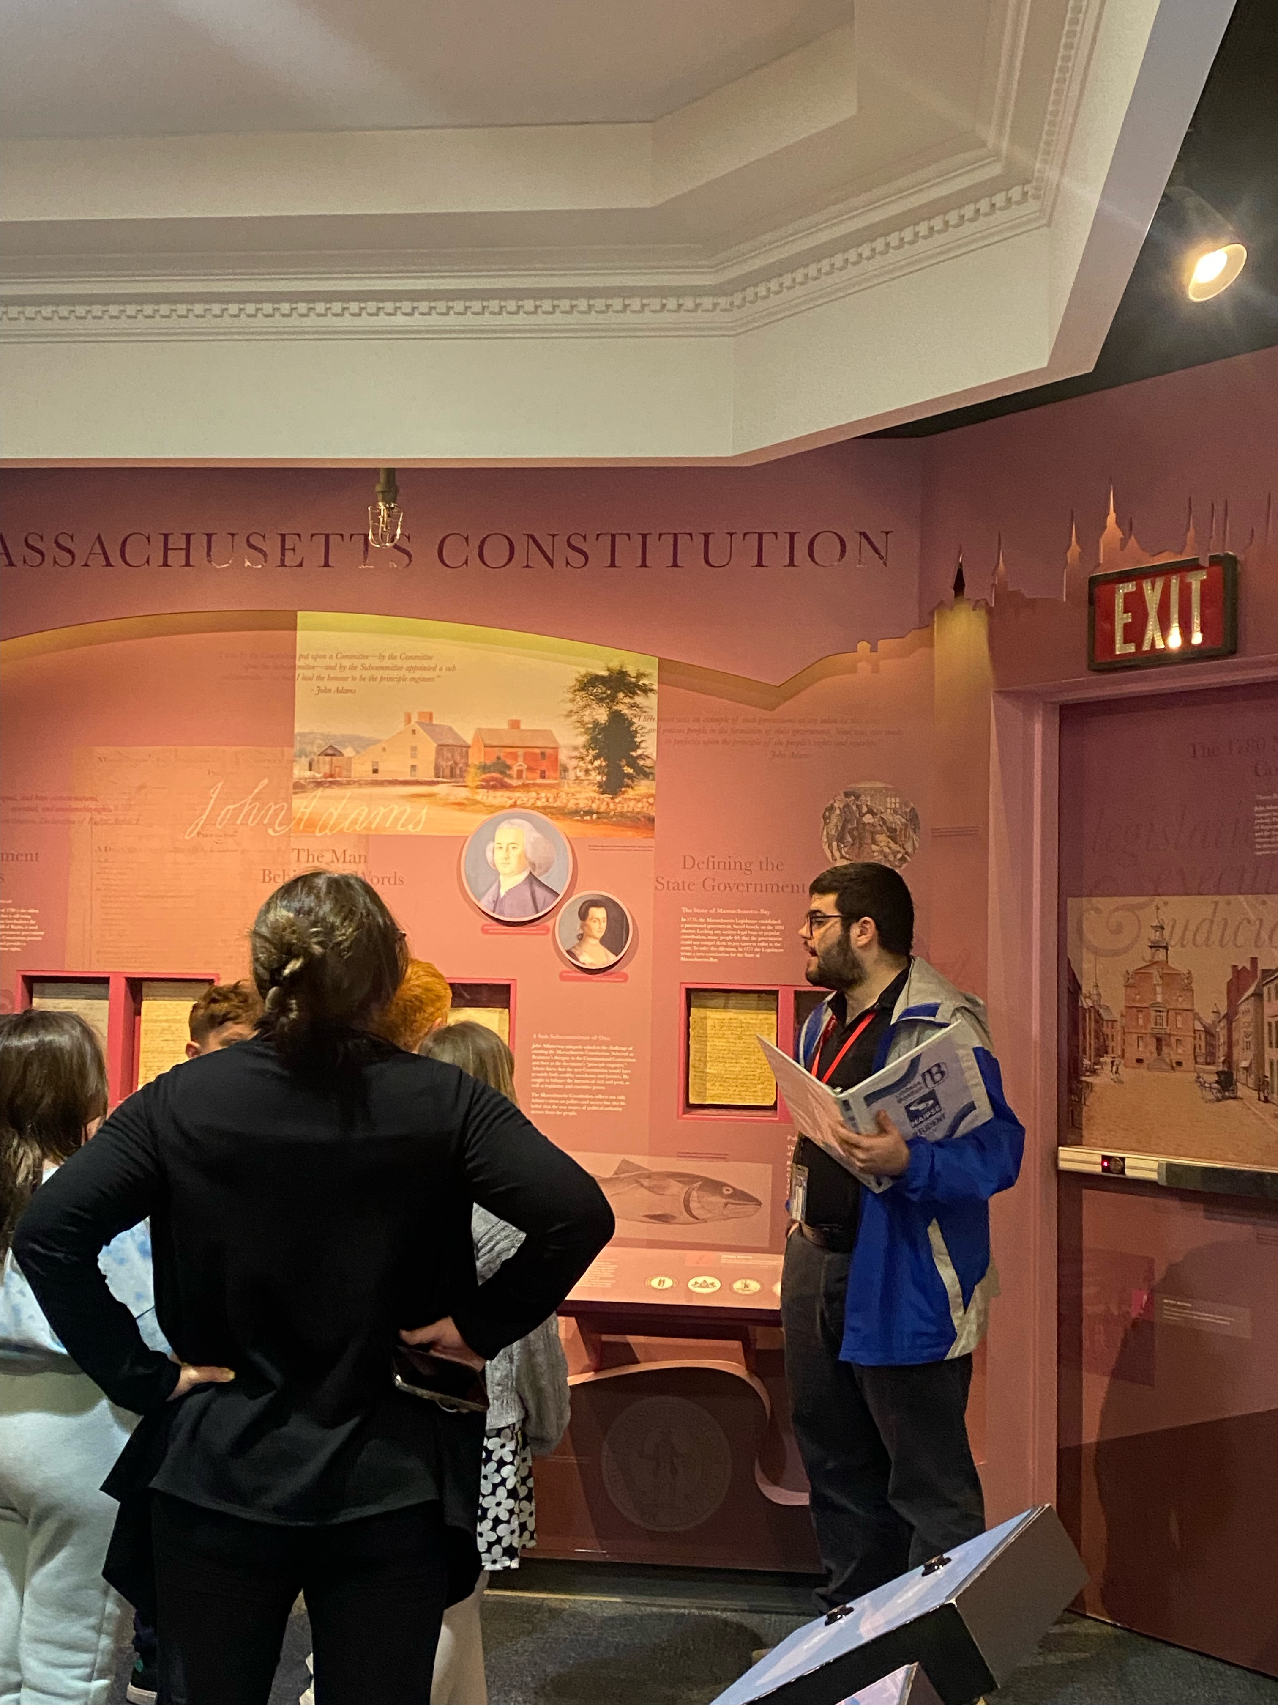
Case study #1
Person Centered Planning
Courses
Related Work Experiences
Result
Goal: To work with animals in a zoo.
- Dinosaurs: A Natural History
- Comic Books in America
- Introduction to Acting
- Popular Culture in America
- Library
- Office of Student Involvement and Leadership
- Residence Hall Mailroom
- Commonwealth Museum
Interested in working in a museum or zoo. Looking for another internship.

Slide 16
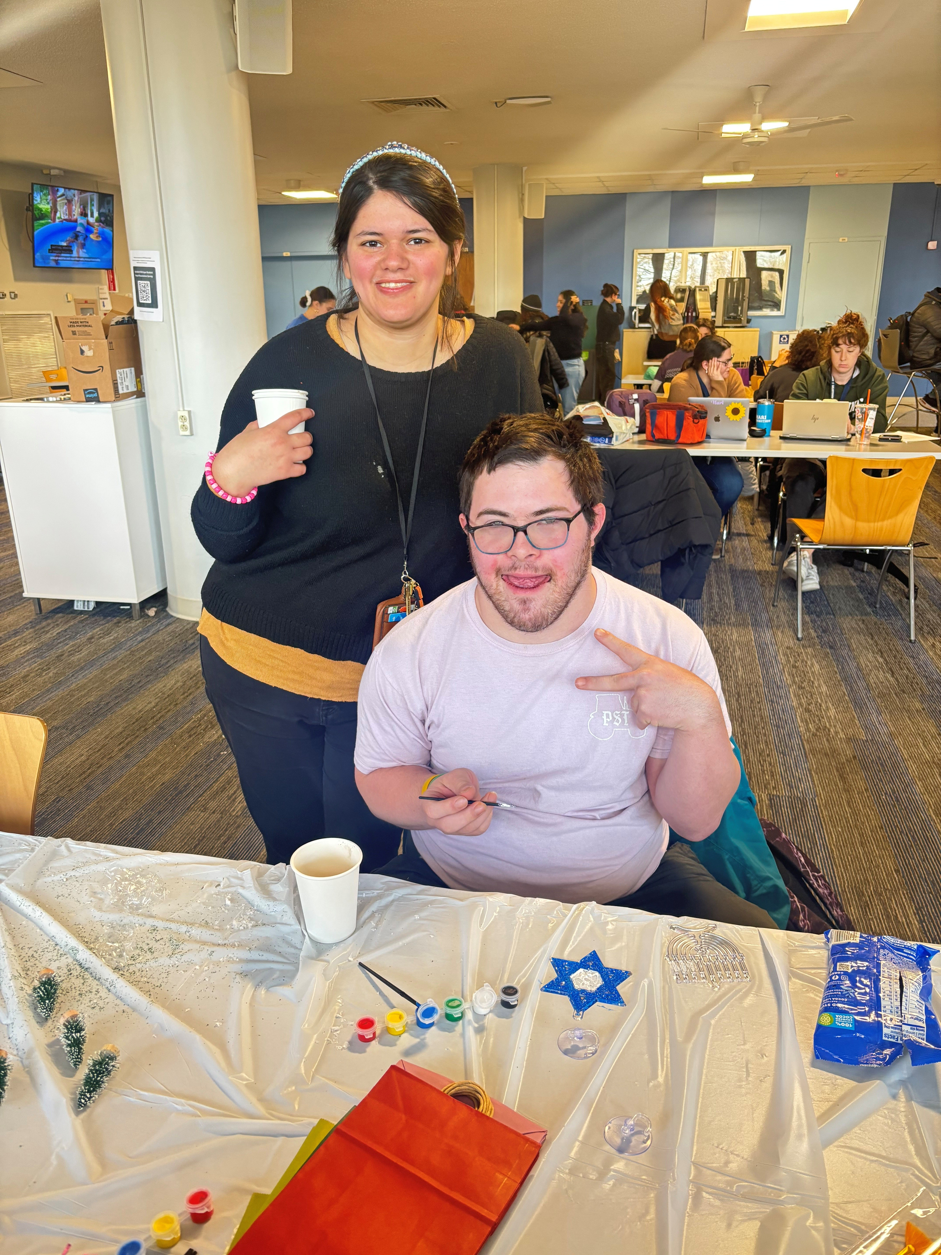
Case study #2
Person Centered Planning
Courses
Related Work Experiences
Result
Goal: To be a receptionist
- Introduction to Communication
- Introduction to Sociology
- Intercultural Communication
- Gender and Communication
- Office of Student Involvement and Leadership
Working with an outside agency to secure employment. Actively looking for receptionist positions and interviewing.

Slide 17
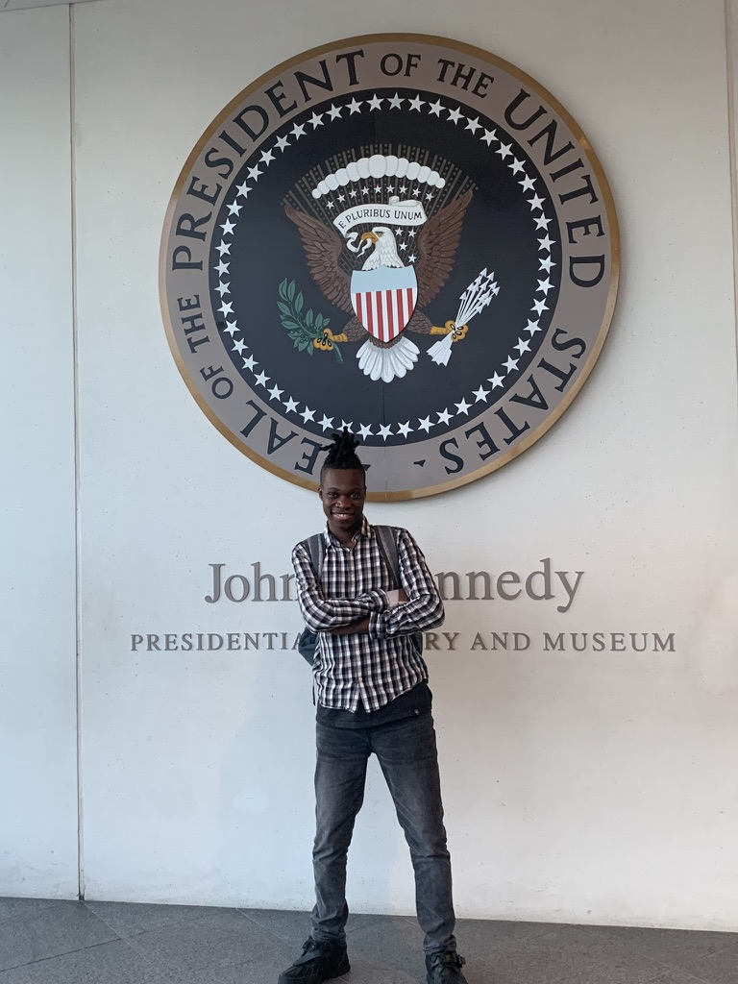
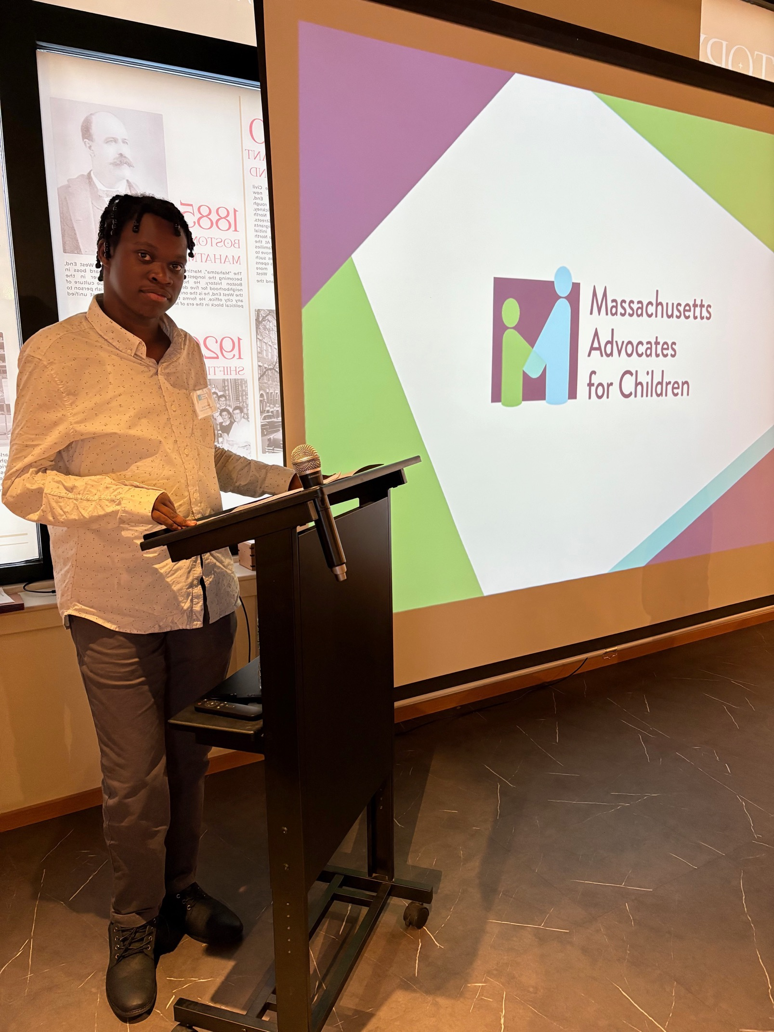
Case study #3
Person Centered Planning
Courses
Related Work Experiences
Result
Goal: To be an advocate and a lawyer
- Introduction to Sociology
- Introduction to Cultural Anthropology
- Historical Thinking and Analysis
- Creative Writing
JFK Library
Office of Student Involvement and Leadership
Residence Life and Housing Office
Completing a paid-work experience as a Fellow for MAC. Planning on continuing education.

Slide 18
Ongoing challenges
Student time on campus
Limited internship opportunities
  Community Colleges vs. Universities
Challenges to create internships
Competition with work study positions
Meeting qualifications (degree seeking student, or expanded hours requirements)

Slide 19
Feedback

Slide 20
Thank you
Feel free to reach us at : macenterta@umb.edu
Maria Paiewonsky: maria.paiewonsky@umb.edu
Ashley Luce: ashley.luce@umb.edu
Rachel Estremera: rachel.estremera@umb.edu

Slide 21
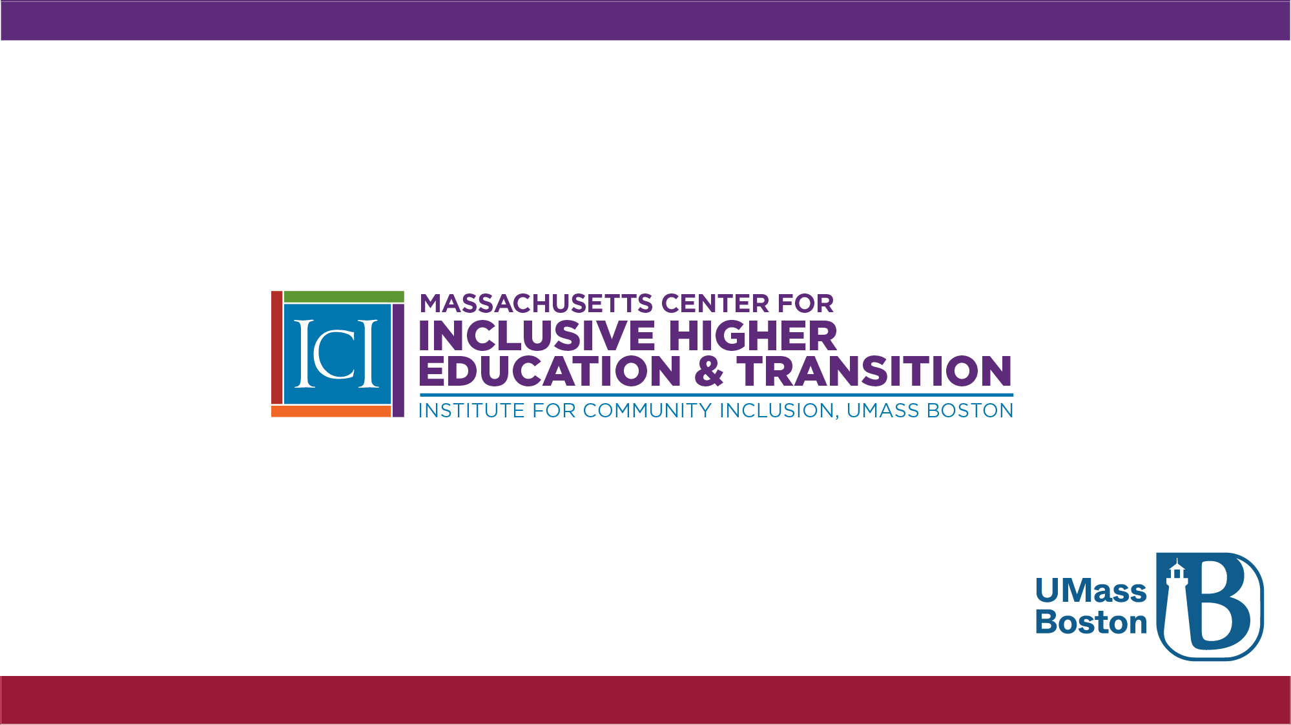
ICI Massachusetts Center for Inclusive Higher Education & Transition

